Slide 1
listen …

Slide 2
GES1011/GESS1009
The Evolution of a
Global City-State

Slide 3
recap …
after the war ...
decolonization ...

Slide 4
recap …
promises of ‘local’ control and increasing autonomy ...
even if compromised by declaration of Emergency in 1948 ...
led to local elections in Singapore ...

Slide 5
recap …
1955: Legislative Assembly with a majority of elected members ...
with control over domestic matters ...
by 1957 ...
British further cede internal security to Lim Yew Hock’s government ...
in 1959, a fully elected Legislative Assembly …

Slide 6
Question and Response

Slide 7
our task today …
briefly look at post-political independence unfoldings ...
economic phases and eventual takeoff ...
we briefly look at the underbelly of economic development ( Menon and Teo You Yenn) …

Slide 8
our task today …
shifting gears …
for this and the next lecture …
not really history …
too ‘recent’ for robust historical inquiry …
but issues of wider general concern …

Slide 9
Question and Response

Slide 10
political independence …
1960s; move towards federating with Malaya, Sabah and Sarawak ...
??? (‘Lee’land limbo) 31 August 1963 ...
Malaysia ( 16 September 1963) ...
(7 August 1965)
Independence of Singapore Agreement 1965
Republic of Singapore (9 August 1965)

Slide 11
political independence …
Independence of Singapore Agreement 1965 ...
was executed on 9 August as agreed ...
political independence/sovereignty for Singapore ...

Slide 12
political independence …
enshrines military dependence ...
water dependence ...
no mention of currency ....
but currency union still in place ...

Slide 13
political independence …
ends with issuance of Singapore dollar in 1967 ...
and until 1972, exchangeable at par value with Malaysia and Brunei ...
Malaysia withdrew in 1972 ...
arrangements with Brunei stands till today ...
(not currency union just agreed exchange rate)

Slide 14
political independence …
only political independence …
why do we not realise this ?
because dependency is a ‘bad’ thing?

Slide 15
political independence …
if you have been paying attention to the various unfoldings in this module …
dependency and/or contingency overwhelmingly mark human history …
we are in this together …

Slide 16
Question and Response

Slide 17
economic phases ...
Singapore politically independent in 1965 …
problem of lack of ‘domestic’ and ‘off-shore’ natural resources …
(Konfrontasi also cut off resources from Indonesian islands south of Singapore)

Slide 18
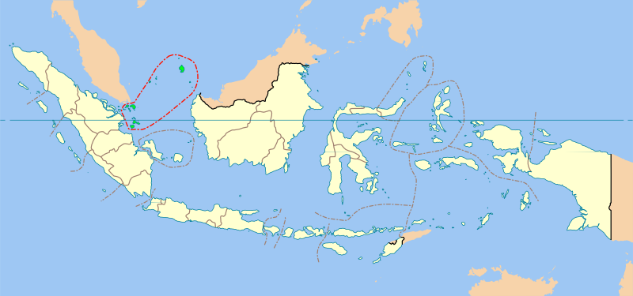
economic phases ...

Slide 19
economic phases ...
rising unemployment …
maritime trade and its offshoots cannot employ enough of working age portion of 1.8 million people …

Slide 20
economic phases ...
population growth in Singapore 1960 to 1990 …
1960 (1.40m)
1970 (2.10m)
1980 (2.40m)
1990 (3.04m)

Slide 21
economic phases ...
economic growth (GDP) in Singapore 1960 to 2000 …
1960-69 (8.7%)
1970-79 (9.4%)
1980-89 (7.5%)
1990-2000 (8.4%)

Slide 22
economic phases ...
economic growth (GDP per capita) in Singapore 1960 to 19900 …
1960 ($1500.00)
1970 ($2832.00)
1980 ($10,714.00)
1990 ($23,139.00)
2015 ($75,000.00)

Slide 23
economic phases ...
economic strategies changed across first five decades (roughly) …
Labour-intensive (import substitution) Industrialisation (1960s)
Export-oriented Industrialisation (1960s-70s)
Cost-Competitive Industrialisation (1980s)
Enterprise Development Industrialisation (1990s)
Economic Globalisation/k-economy (2000-present)

Slide 24
economic phases ...
Labour-intensive Industrialisation (1960)
Singapore encouraged domestic industry towards import substitution ...
items such as mosquito coils, matches, religious combustibles, fishing paraphernalia, slippers, gloves …

Slide 25
economic phases ...
Export-Oriented Industrialisation (1970s)
Singapore imported productive capacity and capital …
attract MNCs to the country …
dominant industrial policy focus was to make Singapore a choice location compared to neighbouring countries …

Slide 26
economic phases ...
strategic trading location, harmonious industrial relations climate, well-equipped physical infrastructure and a relatively skilled workforce, coupled with political stability …
the government’s primary economic objective was to root MNCs in the country to advance the industrialisation process in tandem with its long-term economic progress …
a selectively interventionist approach of industrial policy-making, with MNCs playing a key role, to develop a competitive export-oriented climate …

Slide 27
economic phases ...
import factors of growth …
no mention of indigenous innovation …
leverage success of MNCs …
(note the continuing presence of the international/global)

Slide 28
economic phases ...
MNCs are foreign …
so no apparent government reservations with coming under external corporate influence …
economic dependency underscored …
major MNCs behave like, and have turnovers equivalent to GDPs of small countries …

Slide 29
economic phases ...
Cost-Competitive Industrialisation (1980s)
industrialisation was firmly established in several sectors of industry such as
electronic parts manufacturing
construction and building engineering
logistics
unemployment was no longer a pressing social concern …

Slide 30
economic phases ...
economic recession in 1985 with a negative gross domestic product (GDP) growth of 1.6% came as a rude shock to the political leaders and industrial policy-makers alike …
attributed to the erosion of the country’s cost competitiveness that forced many foreign firms to move their business operations to other surrounding low-cost locations …

Slide 31
economic phases ...
the government learnt an important lesson from the economic recession:
that it is crucial to be cost competitive, coupled with other economic factors of production (such as strong productivity growth) and most importantly, enable firms to implement new cost structures to maintain business competitiveness …
heightened business and financial rationalization needed …
government thinking like a business ….
Singapore Incorporated ???

Slide 32
economic phases ...
financial tinkering with threatened formula of growth …
dominance of the ‘bottom line’ …
focus is outside (as previously) and also backward and sideward (towards competitors) …
again, no emphasis on indigenous innovation …

Slide 33
economic phases ...
Enterprise Development Industrialisation (1990s)
tap more decisively into regional markets for trade and outward investment;
step up the pace of industrial upgrading;
promote innovation, enterprise, and entrepreneurship in the economy …
liberalise various services sectors such as finance, telecommunications, and utilities …

Slide 34
Question and Response

Slide 35
knowledge economy ...
Knowledge Economy (2000- today)
watch ...
watch …
watch …

Slide 36
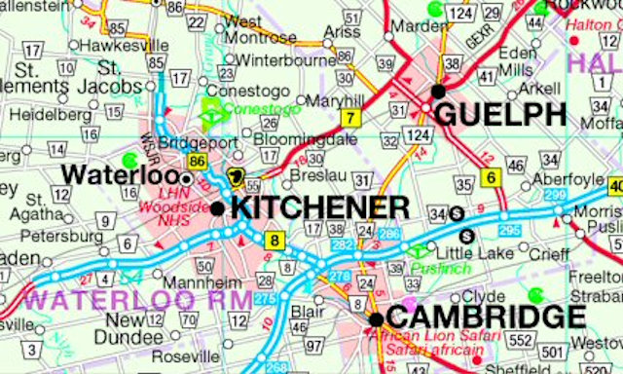
knowledge economy ...

Slide 37
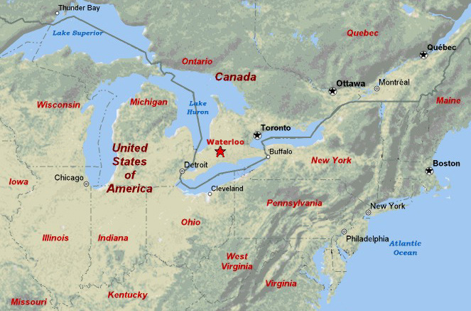
knowledge economy ...

Slide 38
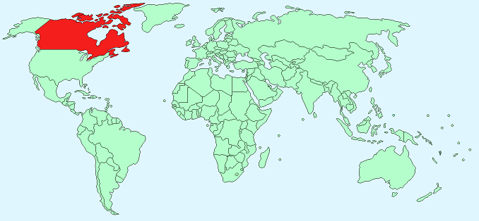
knowledge economy ...

Slide 39
knowledge economy ...
older factors of production:
land
(and sea)
(and what lies beneath both)
labour
capital
ideas ???

Slide 40
knowledge economy ...
ideas/new knowledge …
entrepreneurialism/risk-taking/embracing failure …
interpretation and/or synthesis of information …
deregulation/lower barriers to information …
leveraging IT: connectivity, speed, colossal volumes of data, etc …
sustainability …

Slide 41
Question and Response

Slide 42
Singapore and the knowledge economy …
as a polity largely dependent on human resources, educating the populace is crucial …
but a pressure cooker, ruthlessly meritocratic (academic) system may leave some (many?) behind and unable to contribute to the k-economy…
reforming education needs to embrace creativity and innovation wholeheartedly …

Slide 43
Singapore and the knowledge economy …
reforming education:
MOE kindergartens?
subject-banding?
mixed-ability classes?
less exams?
inter-disciplinarity ?
anything else ?

Slide 44
Singapore and the knowledge economy …
solution ???
response ???
heard anything from the academy or business or government or politicians or NGOs recently …

Slide 45
Singapore and the knowledge economy …
i am not in the business of solving problems …
i historicize them …
partially in the hope that someone (in/with power) realises the character and depth of the problem …
and hopefully, shows us a way forward …

Slide 46
Singapore and the knowledge economy …
while i observe and wait …
i keep listening and thinking …
by chance, i may hear something that resonates with a response …
and five years ago, I think I did …
and six years ago, I heard it again …

Slide 47
Singapore and the knowledge economy …
what do you think ???

Slide 48
Question and Response

Slide 49
Question and Response

Slide 50
underbelly of economic growth (Menon) …
the unequal distribution of income …
income distribution has become more equal, thanks to heavy investments in building human capital and skills as well as a tax and transfers system that has become more progressive …
in 2015, the Gini coefficient after taking account of taxes and transfers was 0.41 …
in 2065, it is projected to be 0.36 …

Slide 51
underbelly of economic growth (Menon) …
wealth inequality has remained more stubborn though…
in 2065, it is projected that the top 1% and 10% of wealth holders in Singapore own around 20% and 60% of total wealth respectively …
little will have changed from 2015 …

Slide 52
underbelly of economic growth (Teo) …
the story of Singapore as a shining global city:
we were poor but we are now rich !!!
stories of successful social mobility …
opportunities for mobility are promised, not outcomes …
inequality a logical outcome of meritocracy (fair competition) …
‘we’ ???

Slide 53
underbelly of economic growth (Teo) …
what of those who have stood still ?
those left behind ?
hard to measure …
Singapore has no official poverty line …
Teo spoke to those in rental housing (less than SGD 1500 per month per household ) …
we have not one city but multiple cities …

Slide 54
underbelly of economic growth (Teo) …
city of promise for some …
city of limited movement for others …
inequality is about numbers …
but it is also experiential (a lived reality) …
a big barrier to accepting the realness of poverty and inequality is our story of a shining global city …
we need to change our narratives** …

Slide 55
underbelly of economic growth (global) …
inequality in Singapore is an instance of a wider global problem …

Slide 56
an all important matter of human dignity …

Slide 57
Question and Response

Slide 58
Final Test: Questions will be emailed to you and also available on Luminus.
Take Home Open Book Test (20%)
Date: 11 November 2022
Time of Release: 6:00 p.m.
Time Allowed: 24 hrs
Submission: into designated LumiNUS Workbin .
I will be available via Zoom for the first 30 minutes should you have any questions

Slide 59
Question and Response

